Slide 1

Database Design Using MySQL
MySQL Overview

Slide 2
What is MySQL?
MySQL is a popular open source relational database, that is powerful, reliable and scalable
MySQL can be integrated into web applications written in multiple languages
Created in 1995 by Michael Widenius
Open source and uses the GNU General Public License
Now owned by the Oracle Corporation
Used with the extremely popular LAMP
web software stack (Linux, Apache, MySQL, PHP)

Slide 3
MySQL Features
Here are some of the powerful features of MySQL
Complete Foreign Key Support
Triggers
Stored Procedures
Full Text Indexing and Searching
Query Caching
Replication
Security
Seamless Integration With PHP & Other
Languages

Slide 4

Platforms
MySQL is available for 12 platforms
Windows
Linux
Mac OSX
Novell Netware
FreeBSD
OpenBSD
Solaris
HP-UX
IBM AIX
QNX
SGI IRIX
DEC OSF

Slide 5

Applications that use mysql
MySQL is used by many popular open source applications
Joomla
Wordpress
Drupal
TYPO3
phpBB
Modx

Slide 6
MySQL Editions
There are a few different editions that vary in price and support
Community Edition – Free widely used edition
Standard Edition - $2,000 USD
Enterprise Edition - $5,000 USD
Cluster Carrier Grade Edition - $10,000 USD
For a list of features & comparison
http://www.mysql.com/products/

Slide 7

Client/Server Architecture
MySQL uses a client/server model with 3 general program categories
The Server – mysqld is the program that manages the databases and tables. It is the only program that touches the actual database
Clients – A client is a program that you can use to communicate with the MySQL server (mysqld). There are many to choose from in both GUI & command-line format
Utilities – Usually used for special purposes. An example is mysqld_safe which starts up and monitors the server.

Slide 8
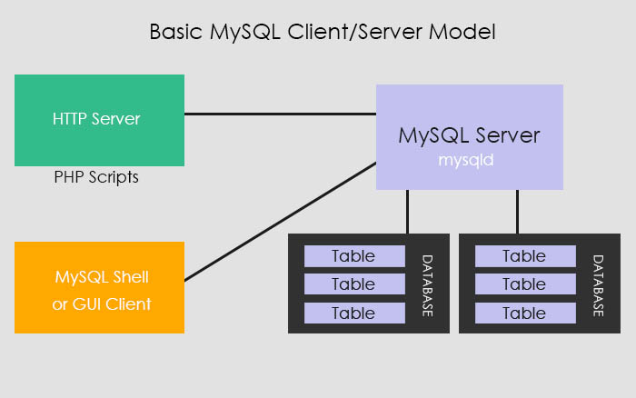
Client/Server Diagram

Slide 9
THAT’S IT!

